Slide 1





Slide 2


My family’s weekend
15
Lesson 1 – Period 1

Slide 3
Table of contents
01
02
03
04
05
Warm-up
Look, listen
and repeat.
Listen, point and say.
Let’s talk.
Game

Slide 4
01
Warm-up

Slide 5

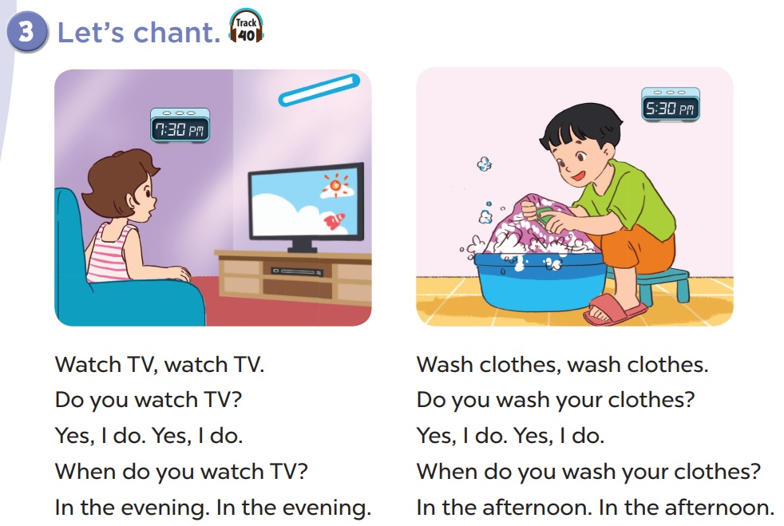

Slide 6
Look, listen and repeat.
02

Slide 7
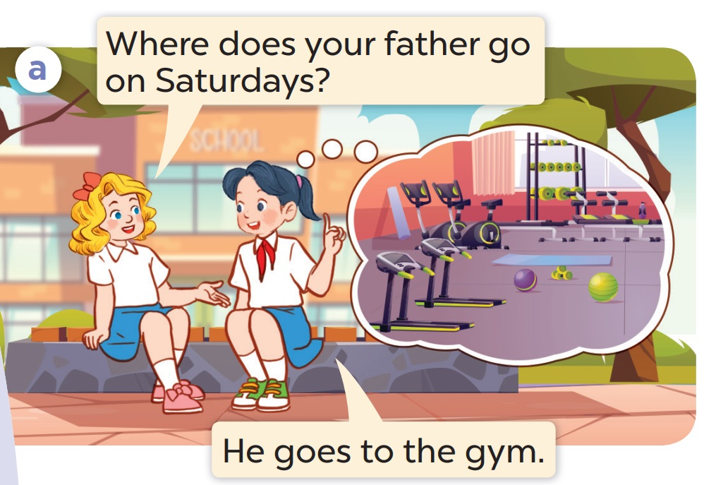
Who are they talking about?
Where does he go?

Slide 8
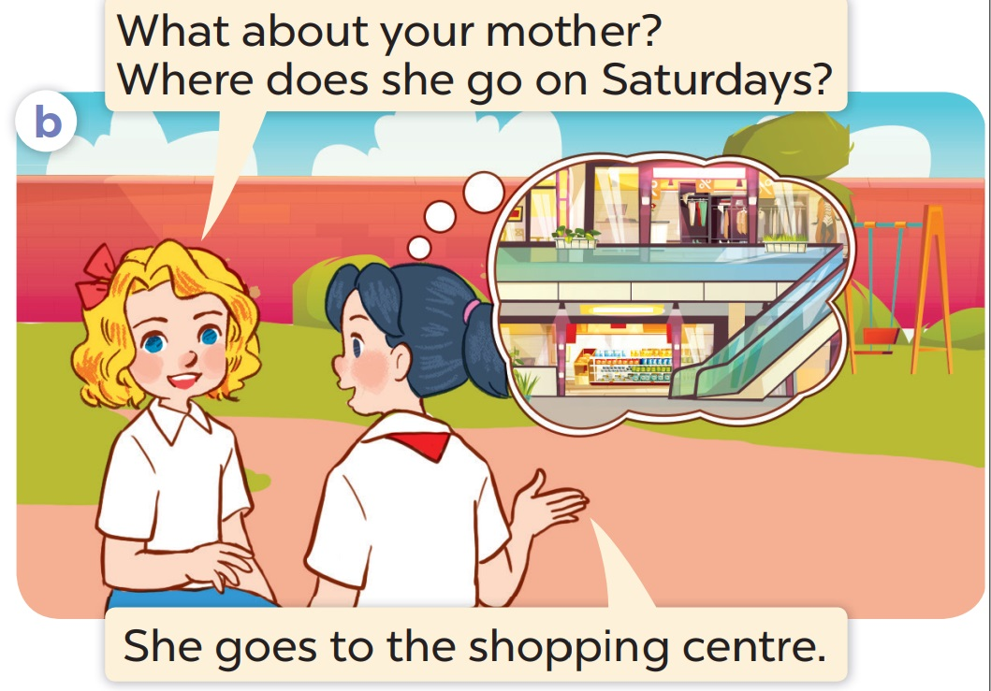
Who are they talking about?
Where does she go?

Slide 9
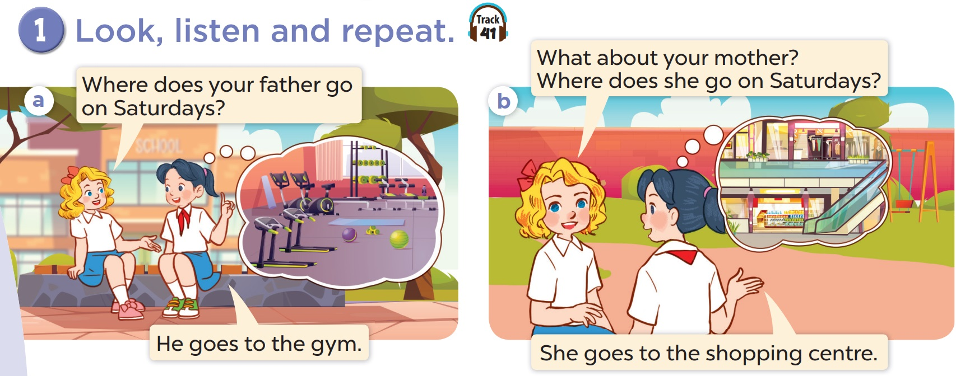

Slide 10
03
Listen, point
and say.

