Slide 2

OUR SPECIAL DAYS
Lesson 3 - Period 6

Slide 3
Table of contents
1
2
3
4
Warm-up
Activity 1
Read and answer.
Activity 2
Let’s write.
Activity 3
Project.
Fun corner
5
Let's play.

Slide 4
01
Warm-up

Slide 5
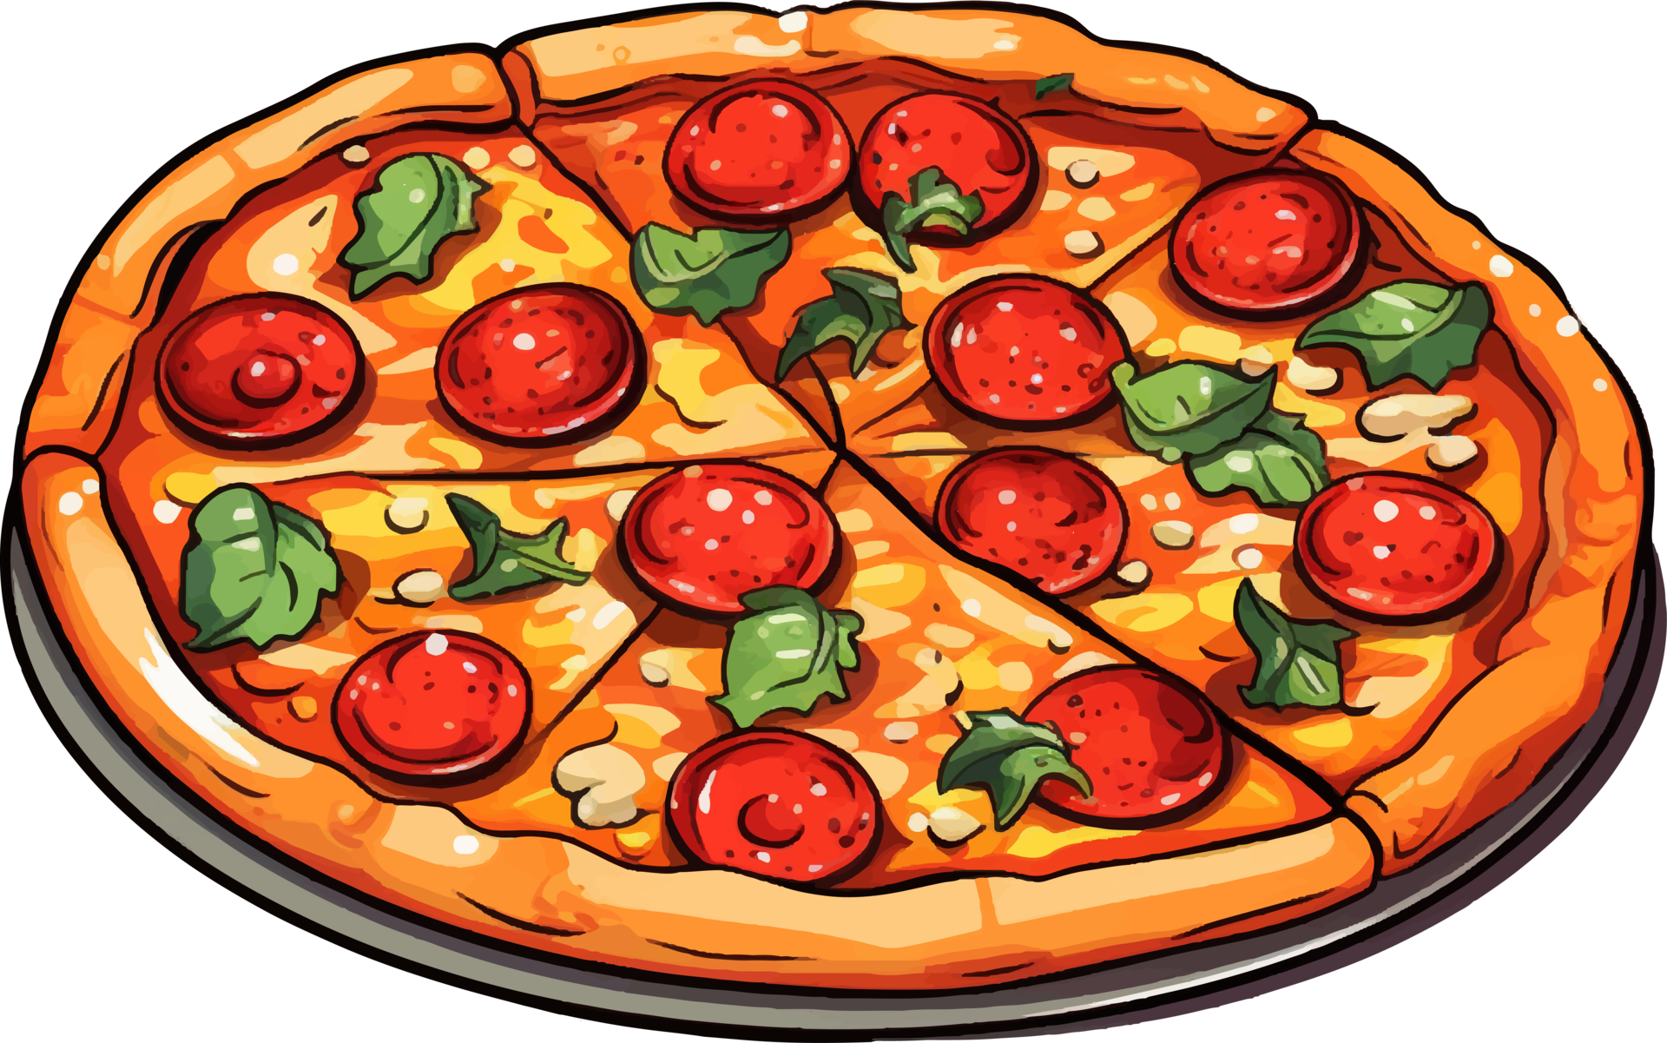
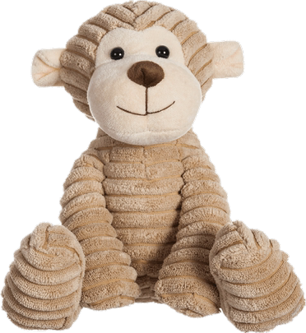
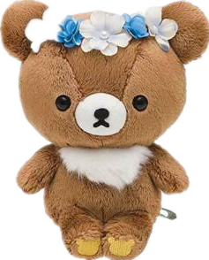
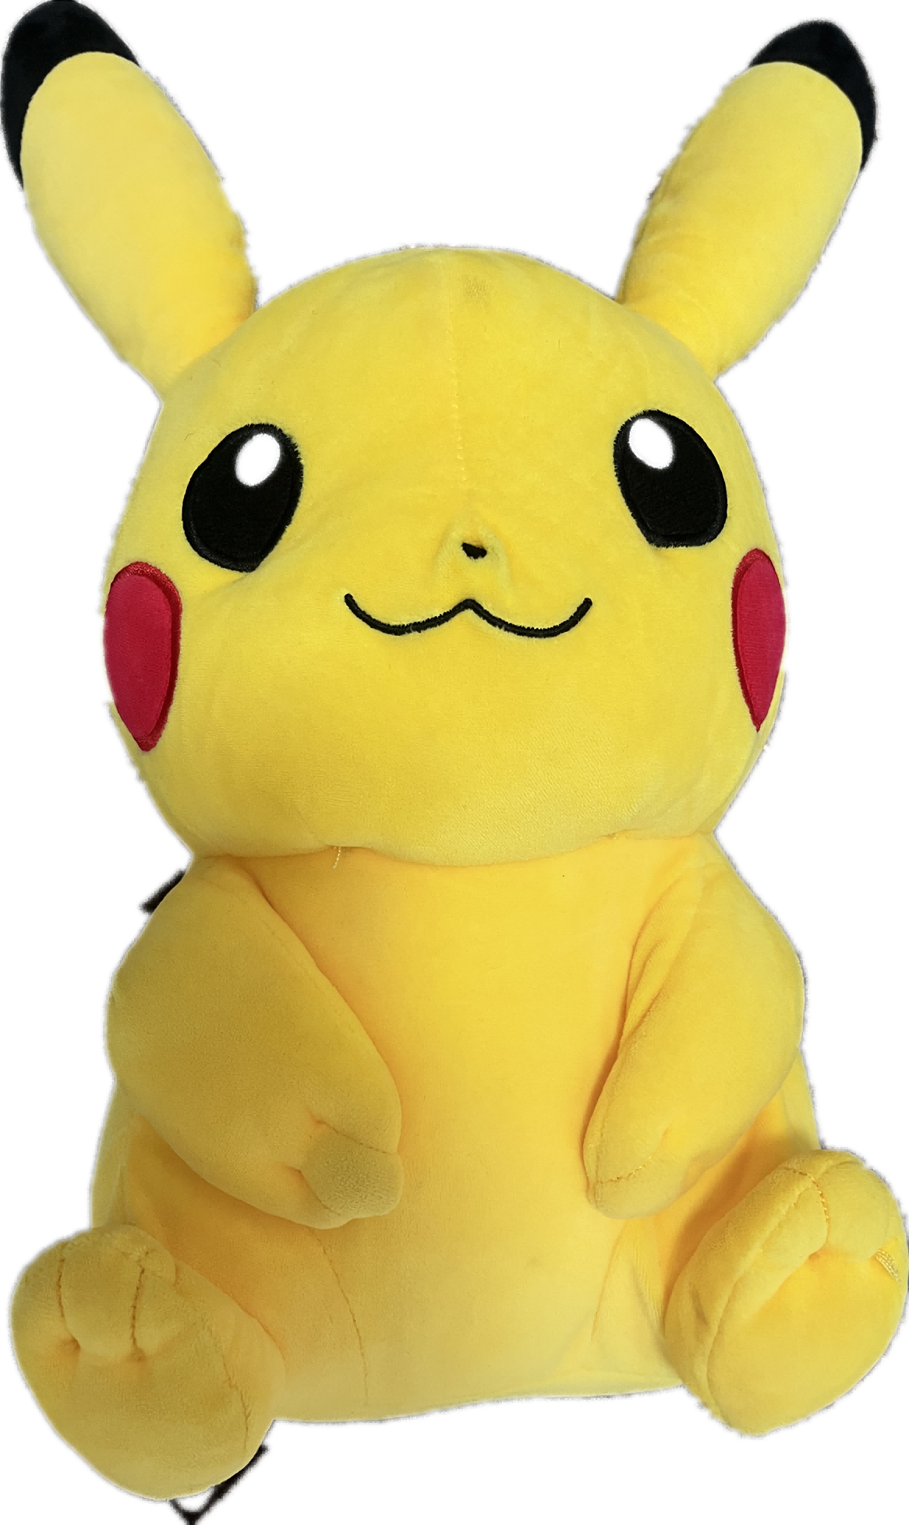
pizza
I will have ………… .
pizza
burger
lemonade

Slide 6
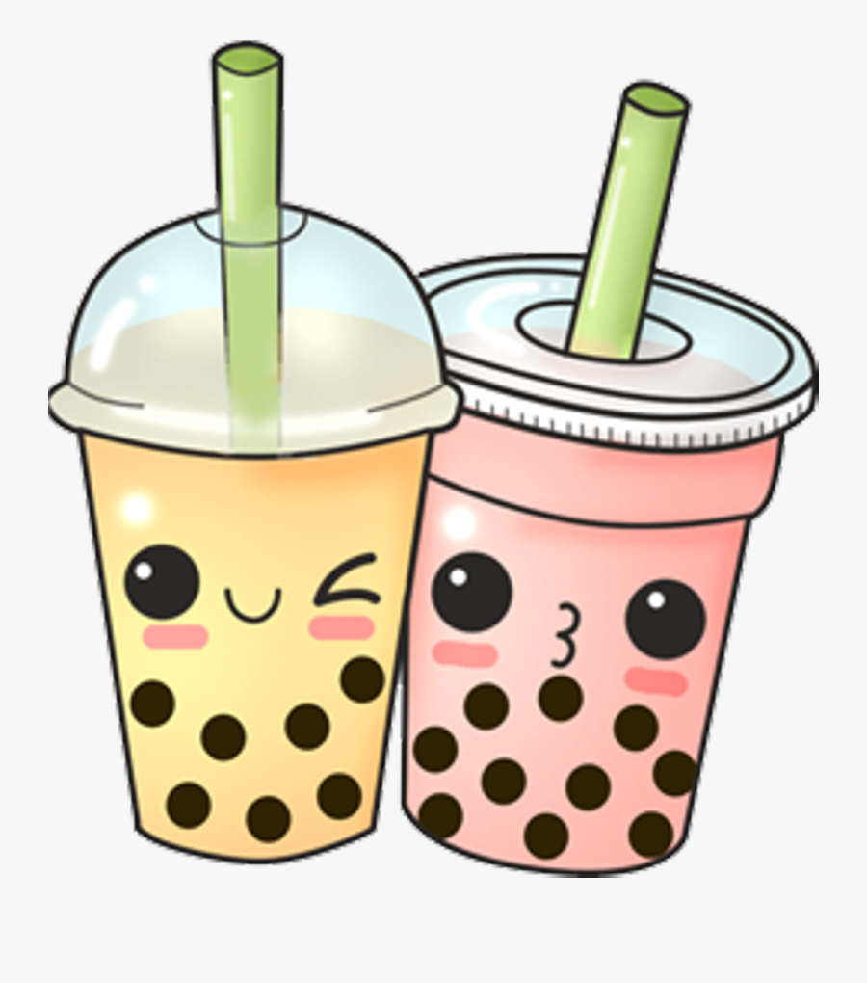
milk tea.
We will have …………….
lemonade
juice
milk tea

Slide 7
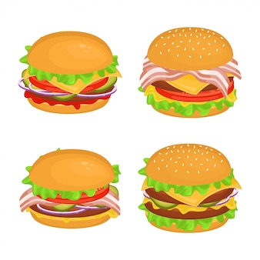
burgers
I will have ………………
cake
burgers
pizza

Slide 8
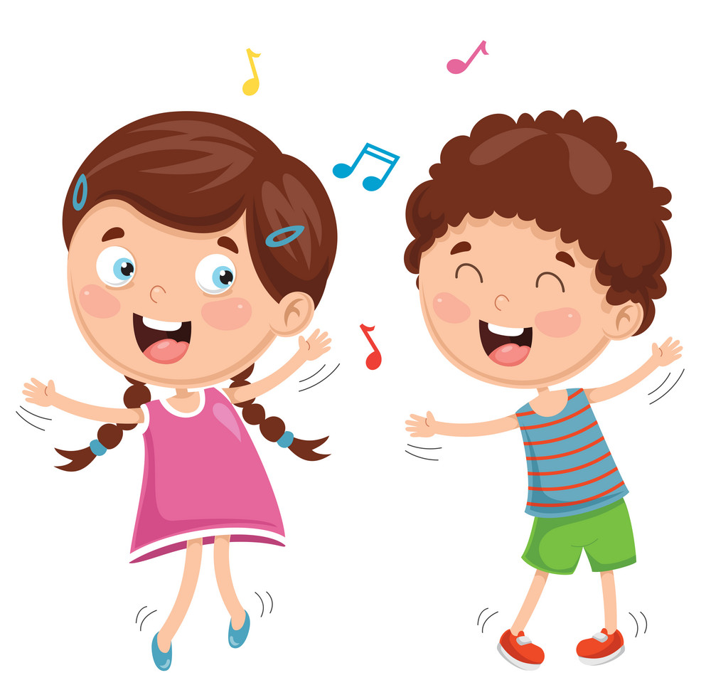
dance
We will ………………
play
sing
dance

Slide 9
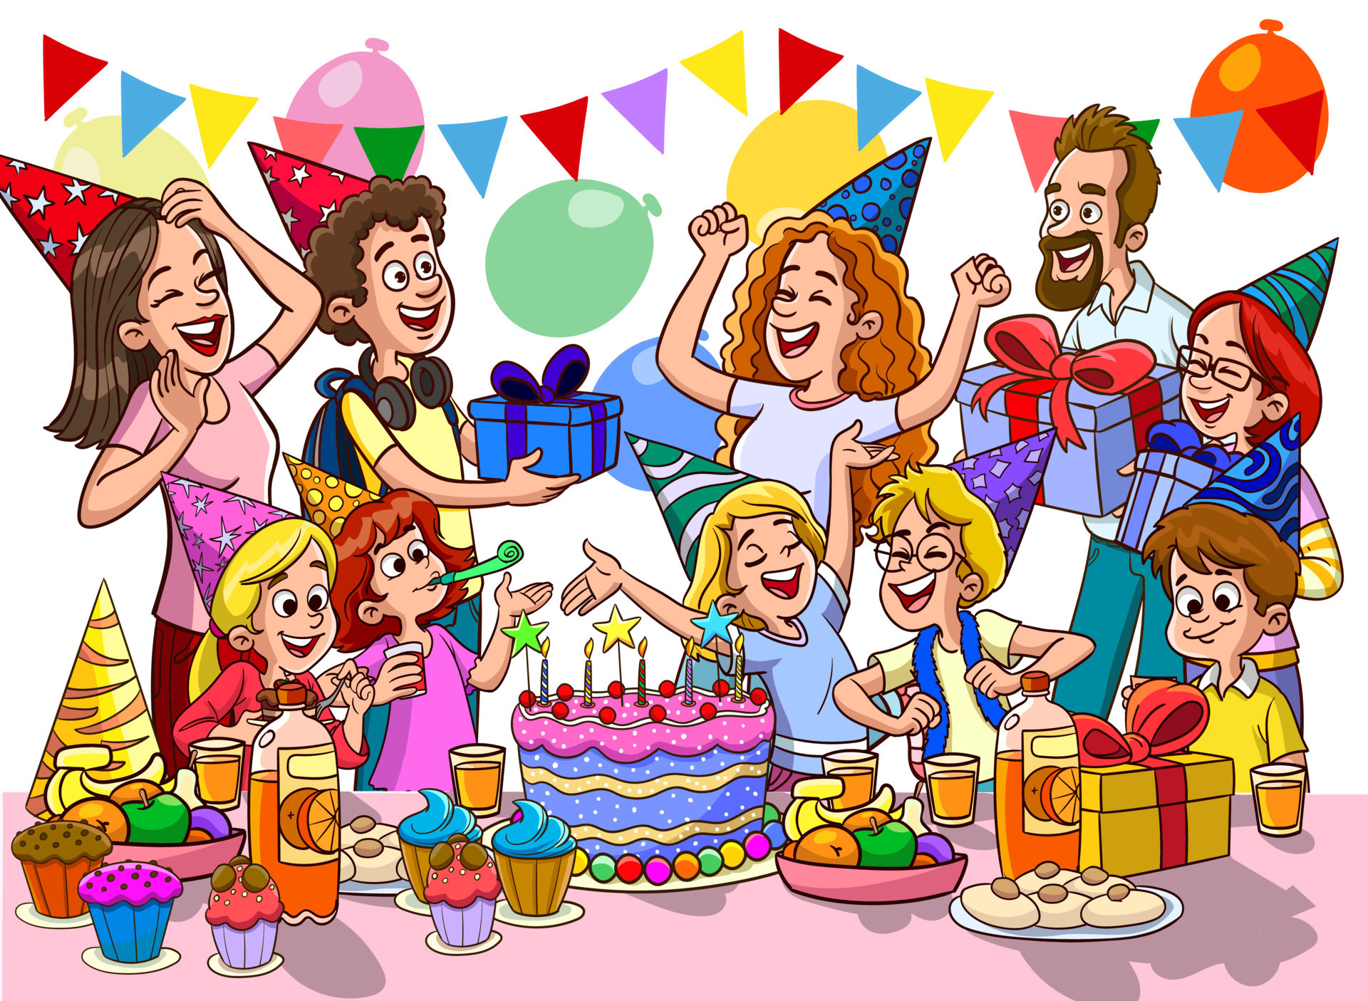
party
I will have a ……………..
party
apple juice
burgers

Slide 10
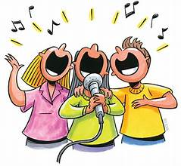
sing
We will ………..
dance
sing
play

Slide 11
02
Activity 1
Read and answer.

