Slide 2




Unit 15
OUR
HEALTH
Lesson 1 – Period 2

Slide 3









Table of Contents
Warm-up and Review
Activity 4: Listen and number.
Activity 5: Read and complete.
Activity 6: Let’s sing.
Fun corner and Wrap-up

Slide 4


01
Warm-up and Review

Slide 5



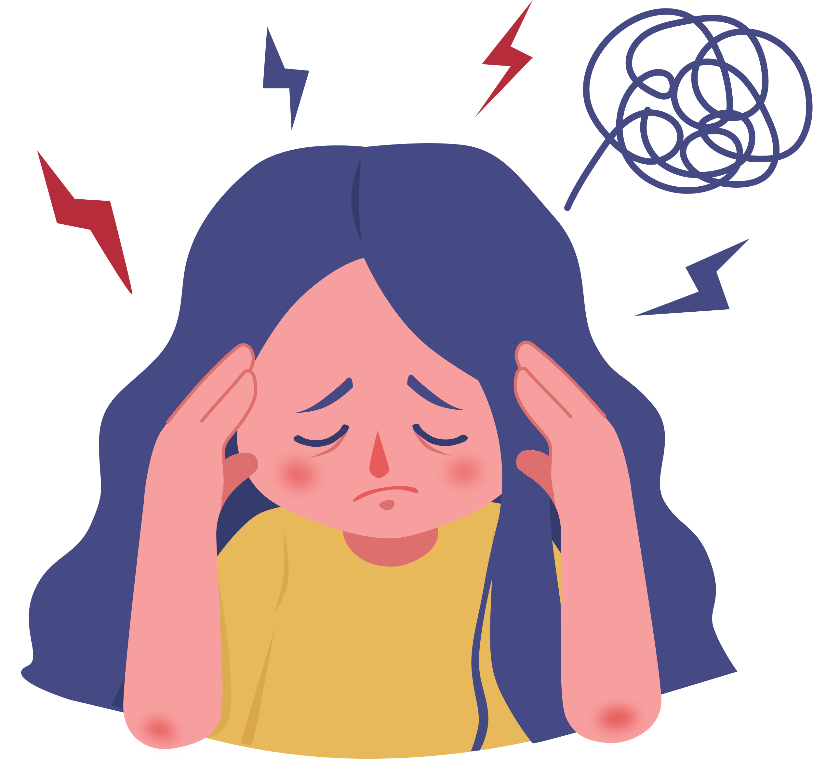
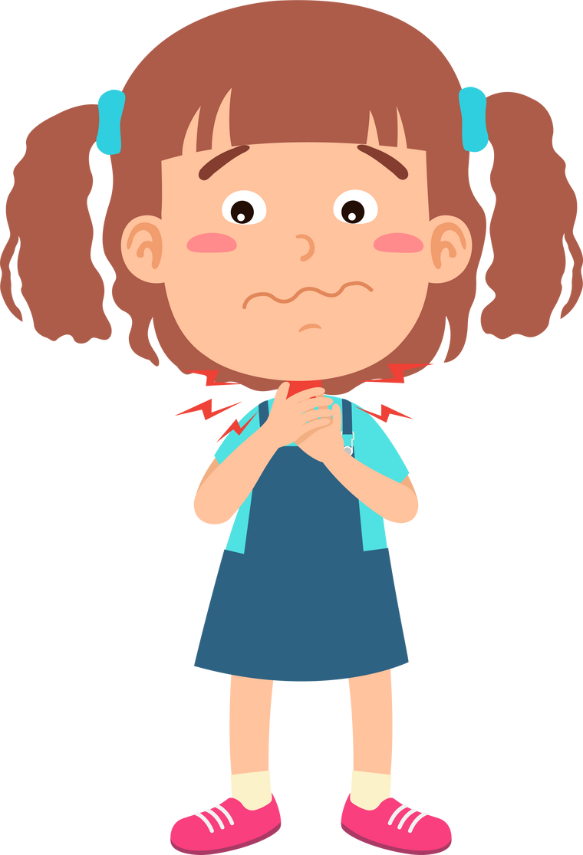
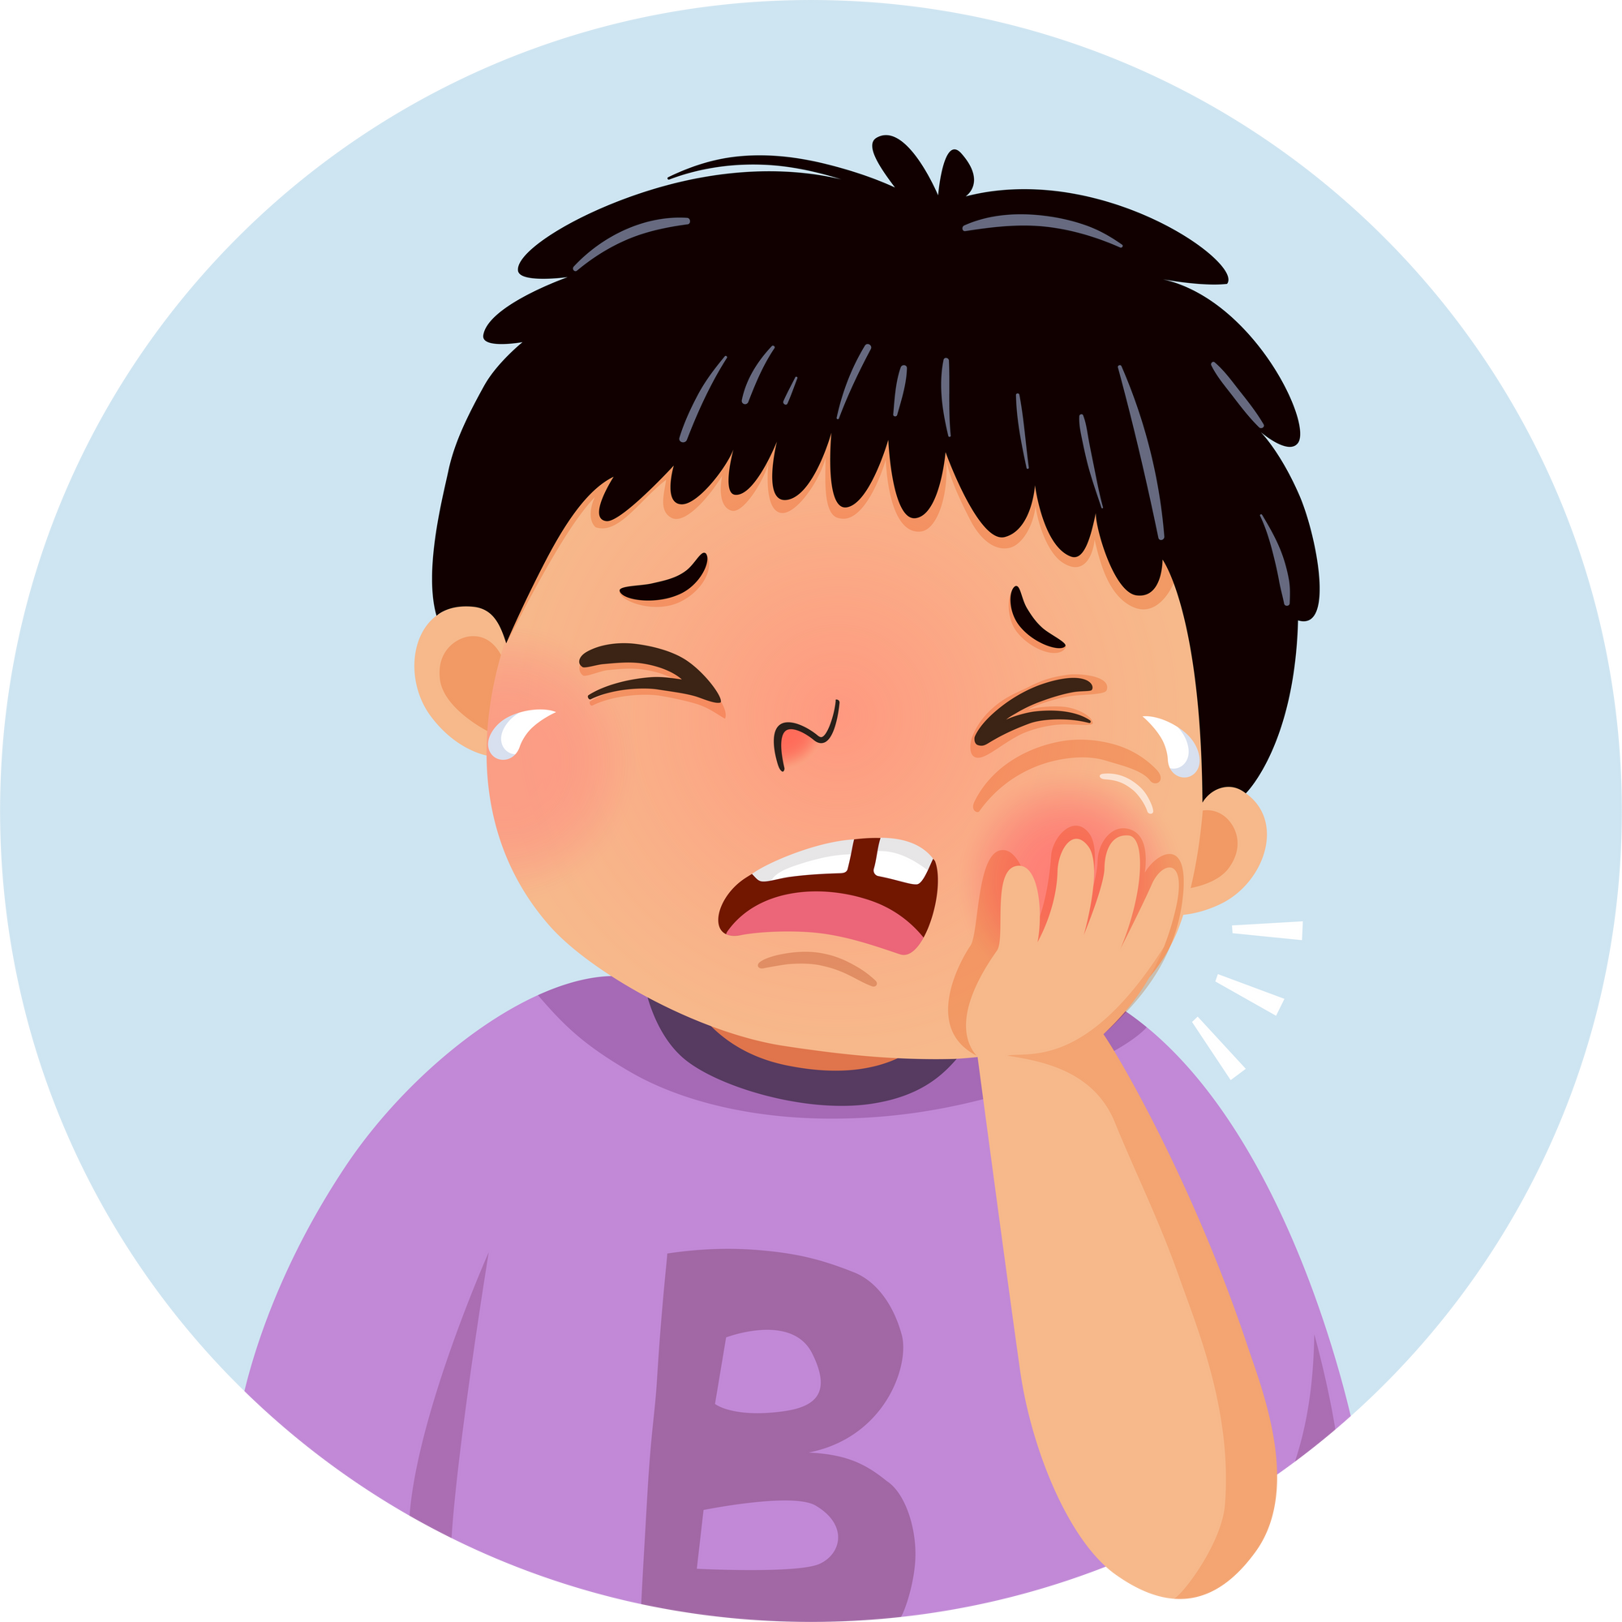
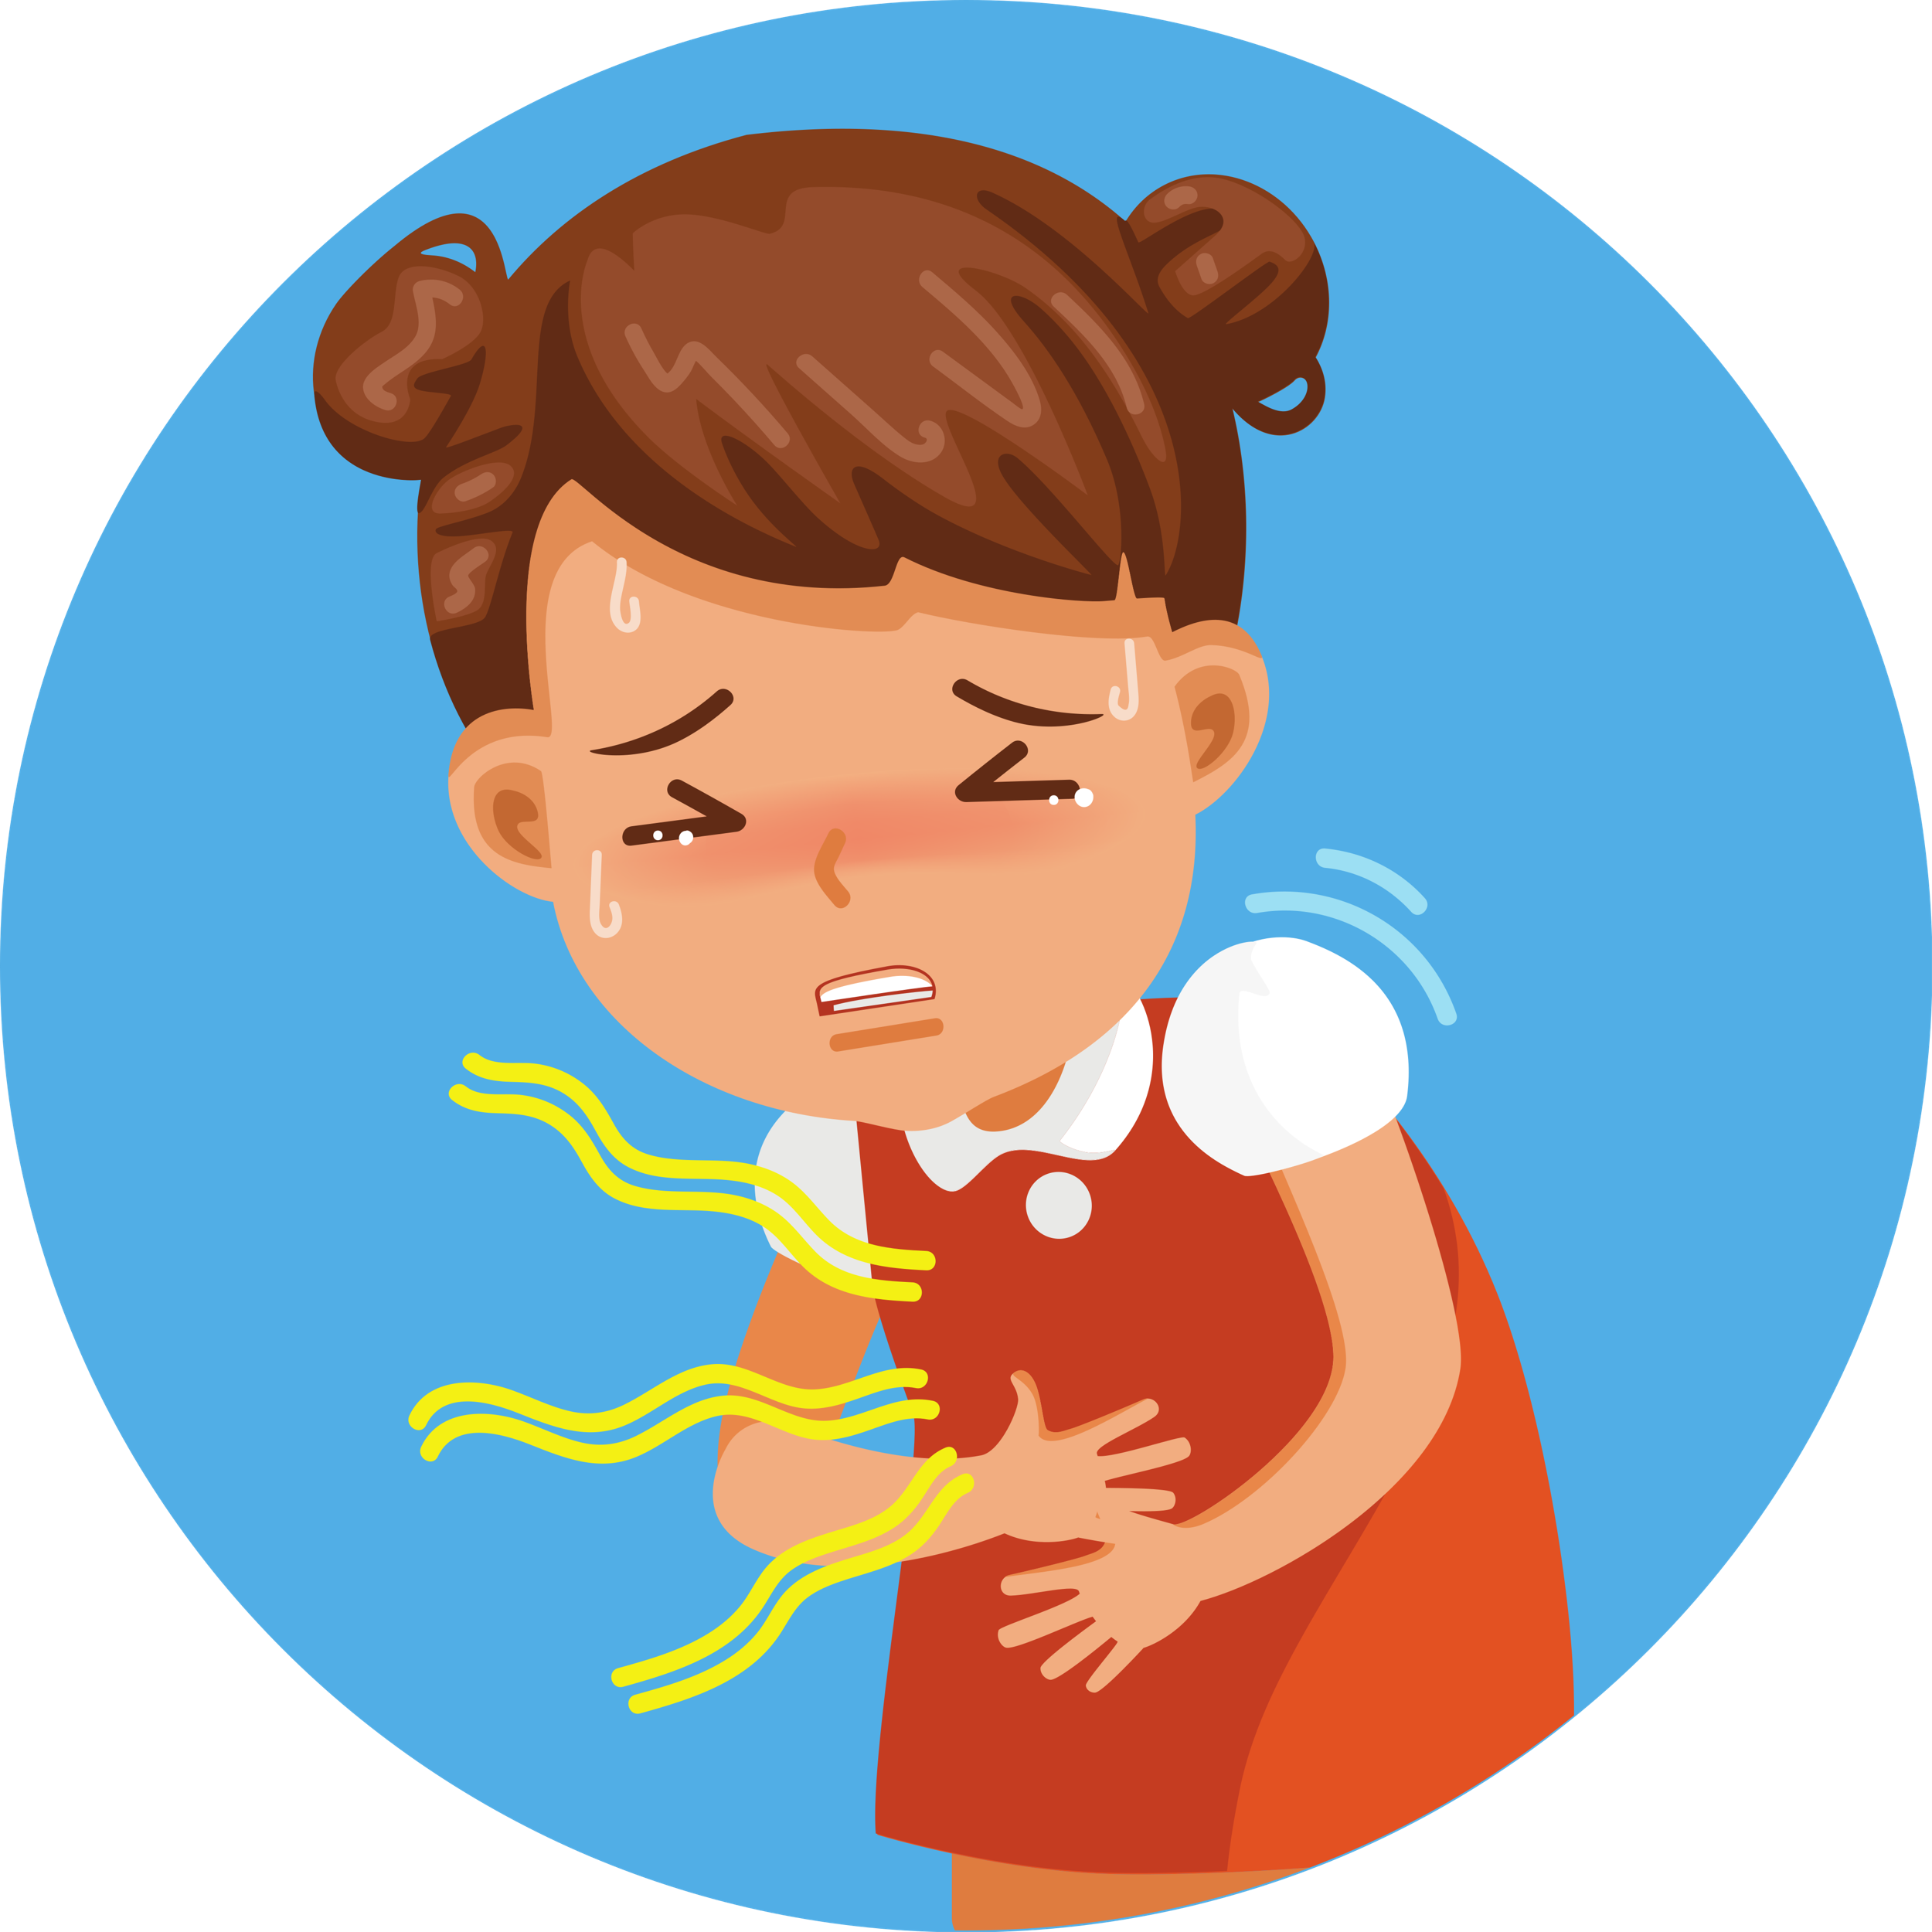
Let’s play Matching Game!

Slide 6


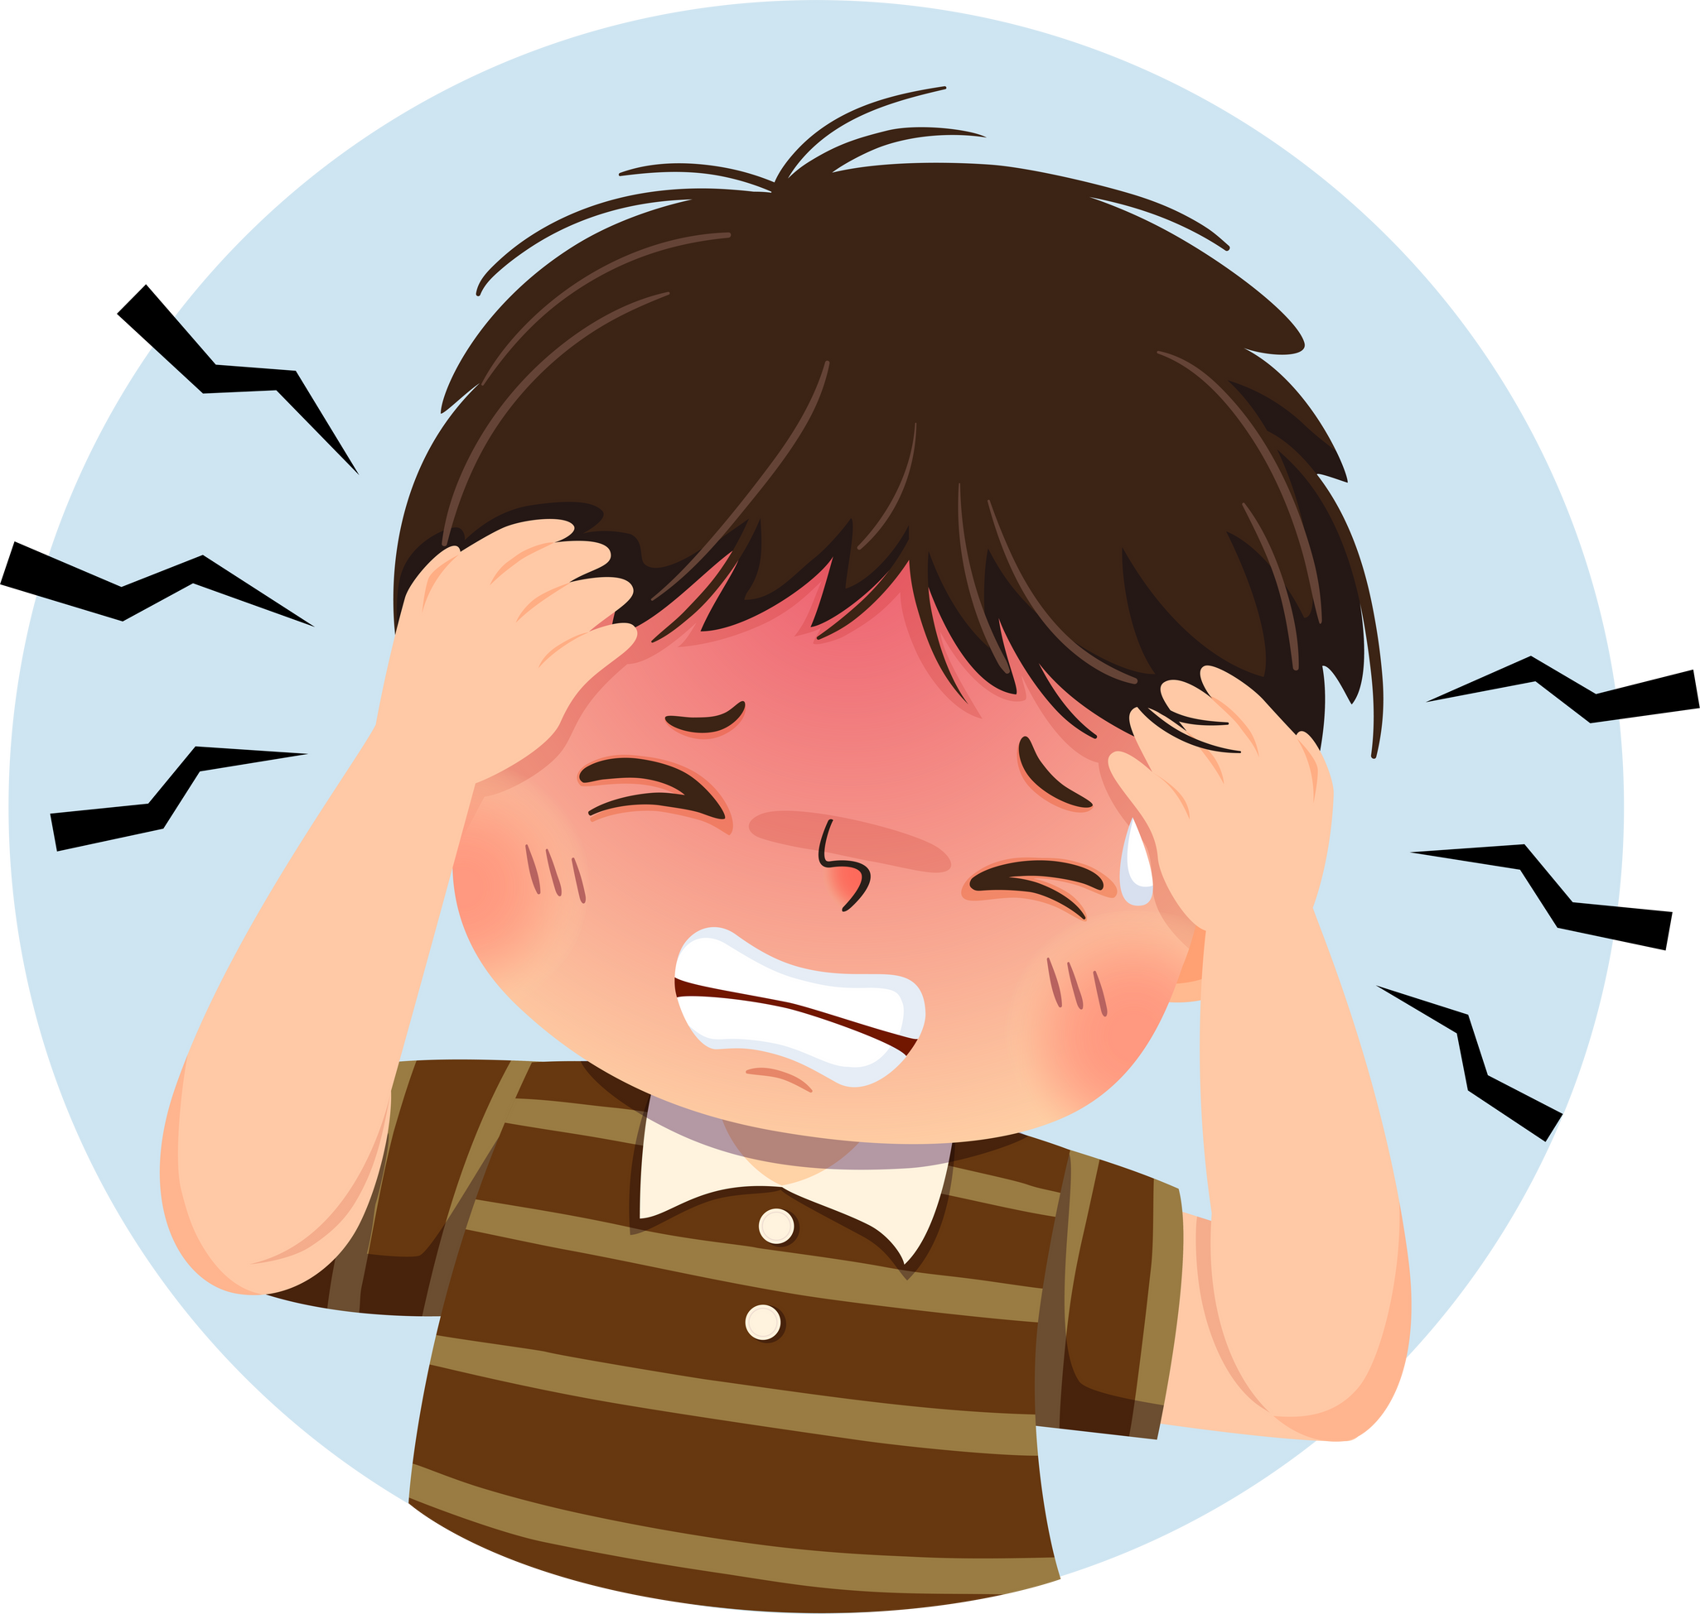
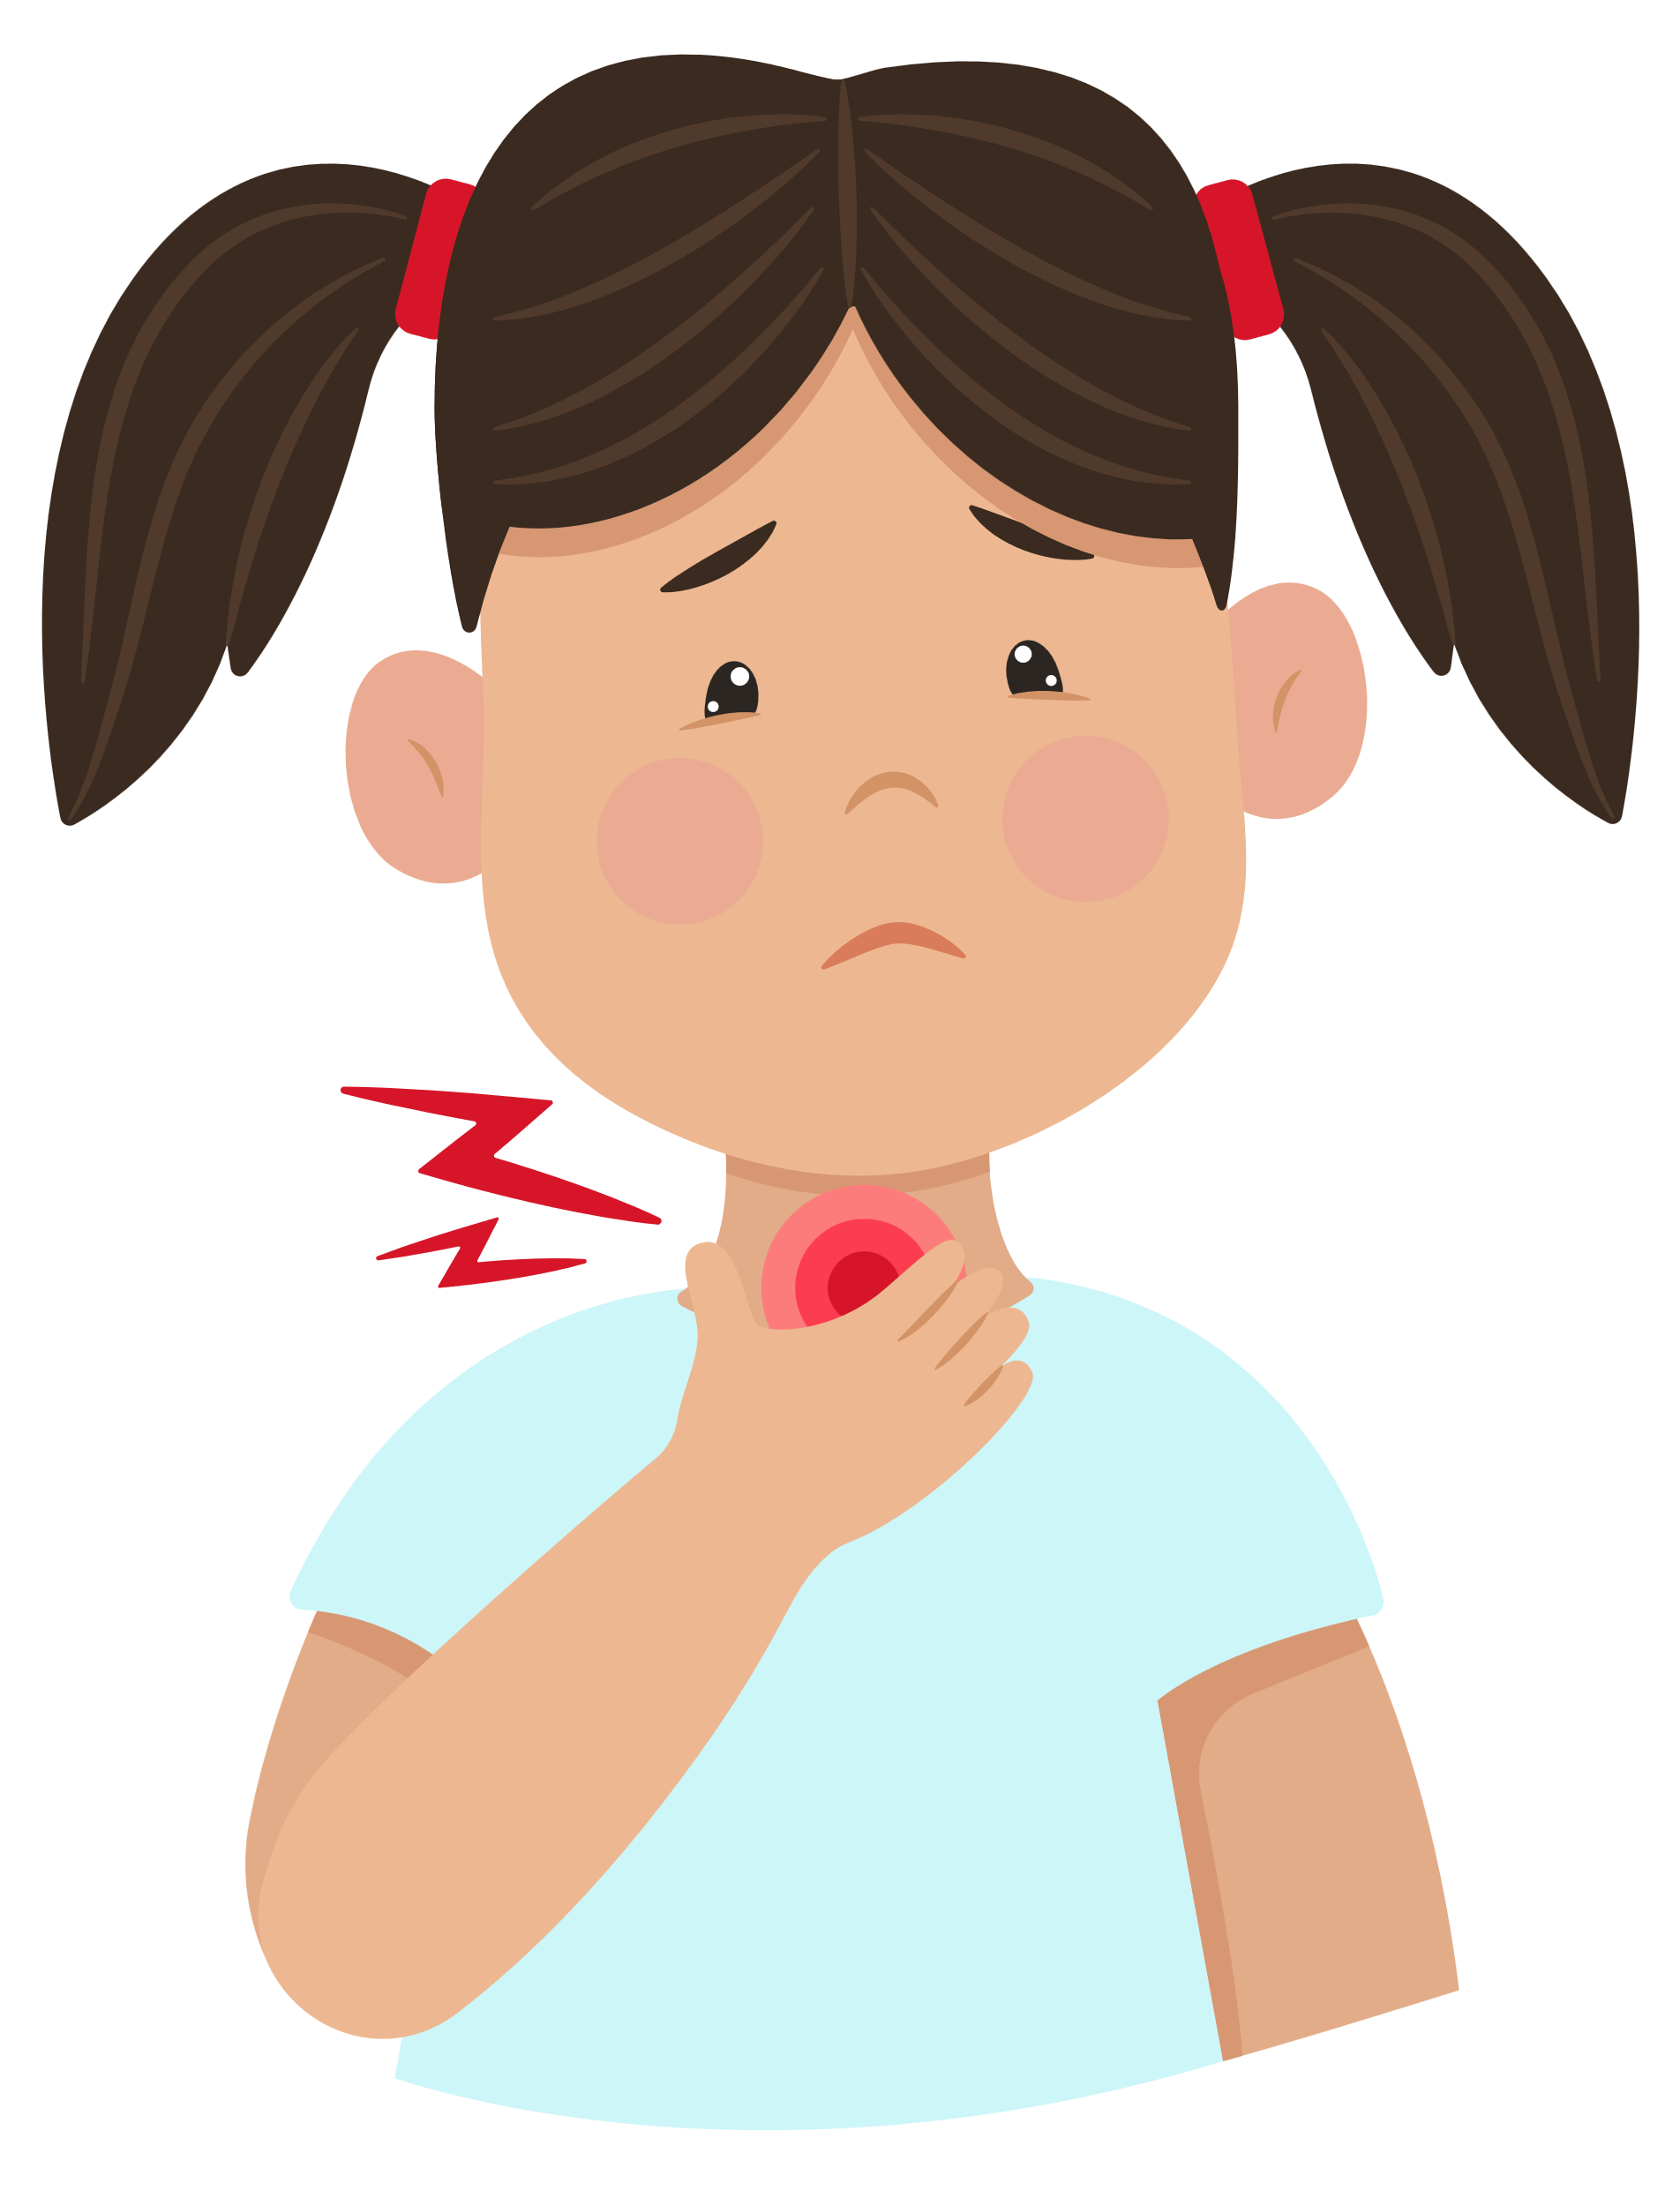
A
1
2
headache
cough
B
3
4
runny nose
sore throat
C
5
6
toothache
backache
D
7
8
stomach
ache
earache

Slide 7



Score Board
Use this to keep track of the points! Copy and paste the token for every point a player receives.
Team 1
Team 2

Slide 8



THANK YOU
FOR PLAYING!

Slide 9
02
Activity 4
Listen and number.

