Slide 1


Slide 2




Unit 15
OUR
HEALTH
Lesson 2 – Period 3

Slide 3









Table of Contents
Warm-up and Review
Activity 1: Look, listen and repeat.
Activity 2: Listen, point and say.
Activity 3: Let’s talk.
Fun corner and Wrap-up

Slide 4


01
Warm-up and Review

Slide 5


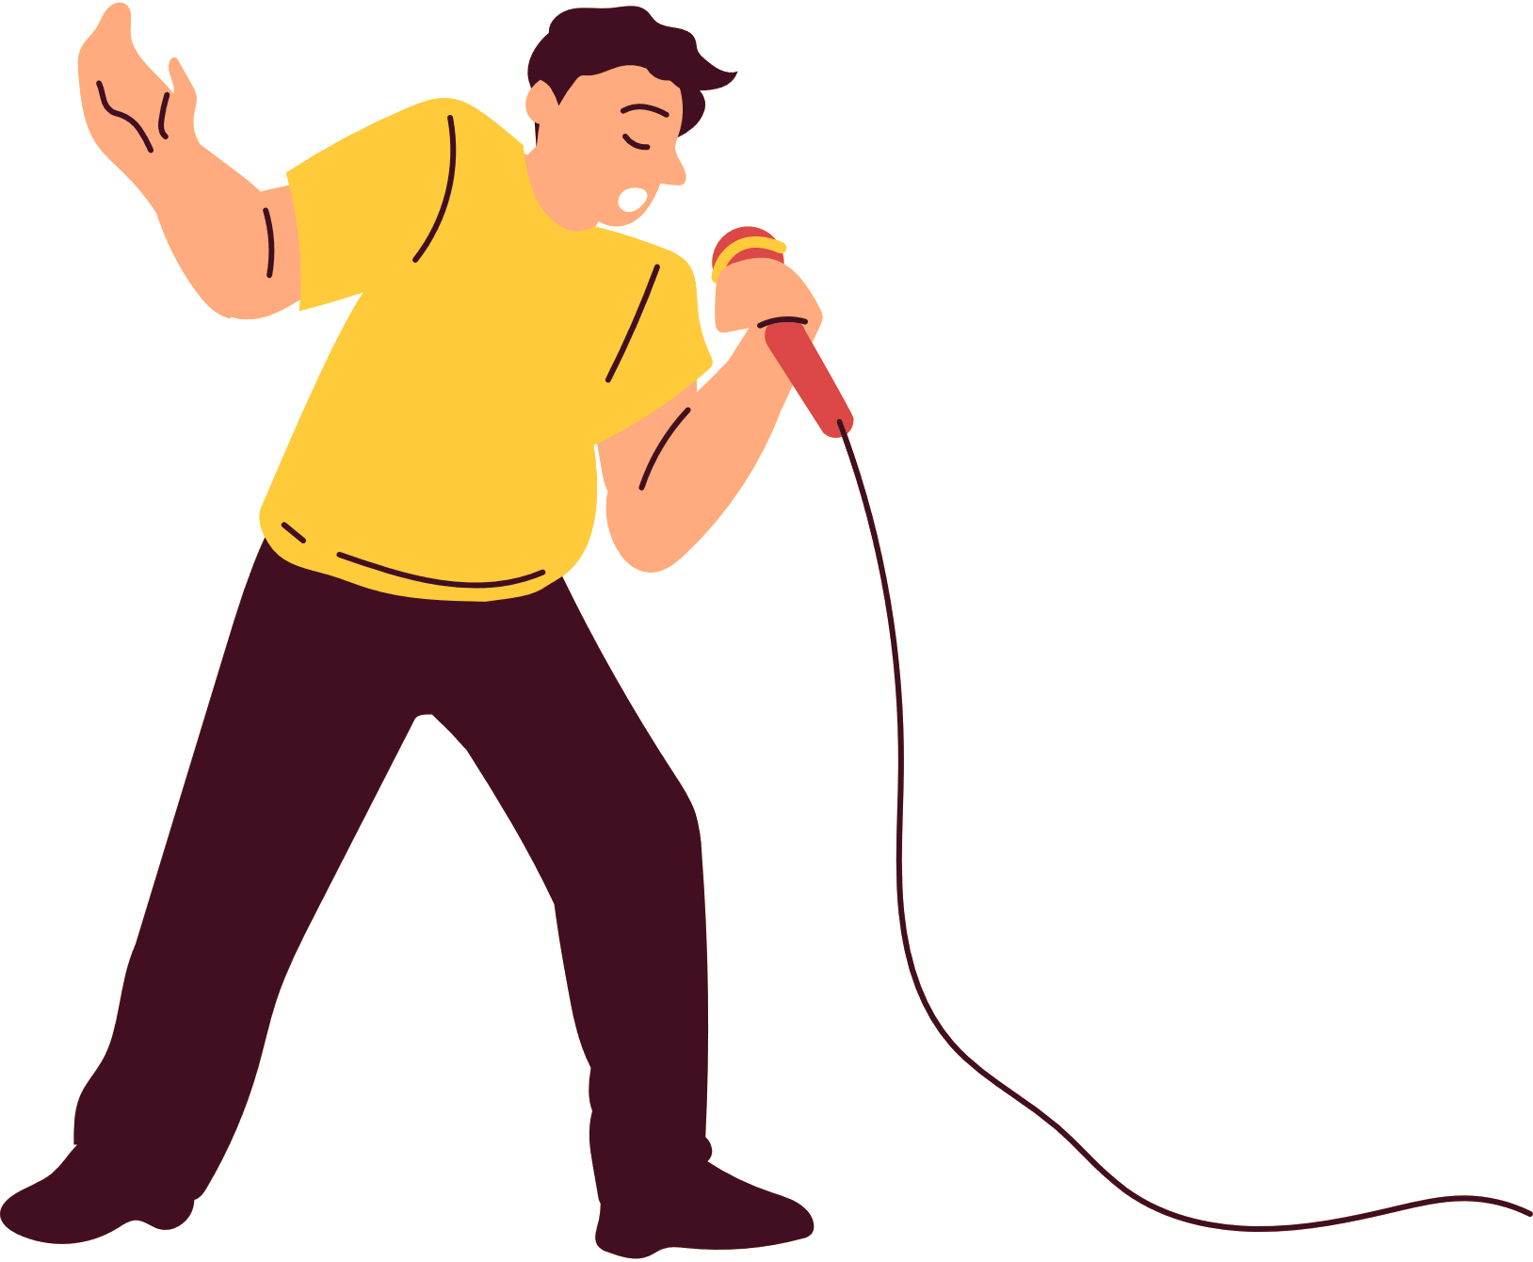
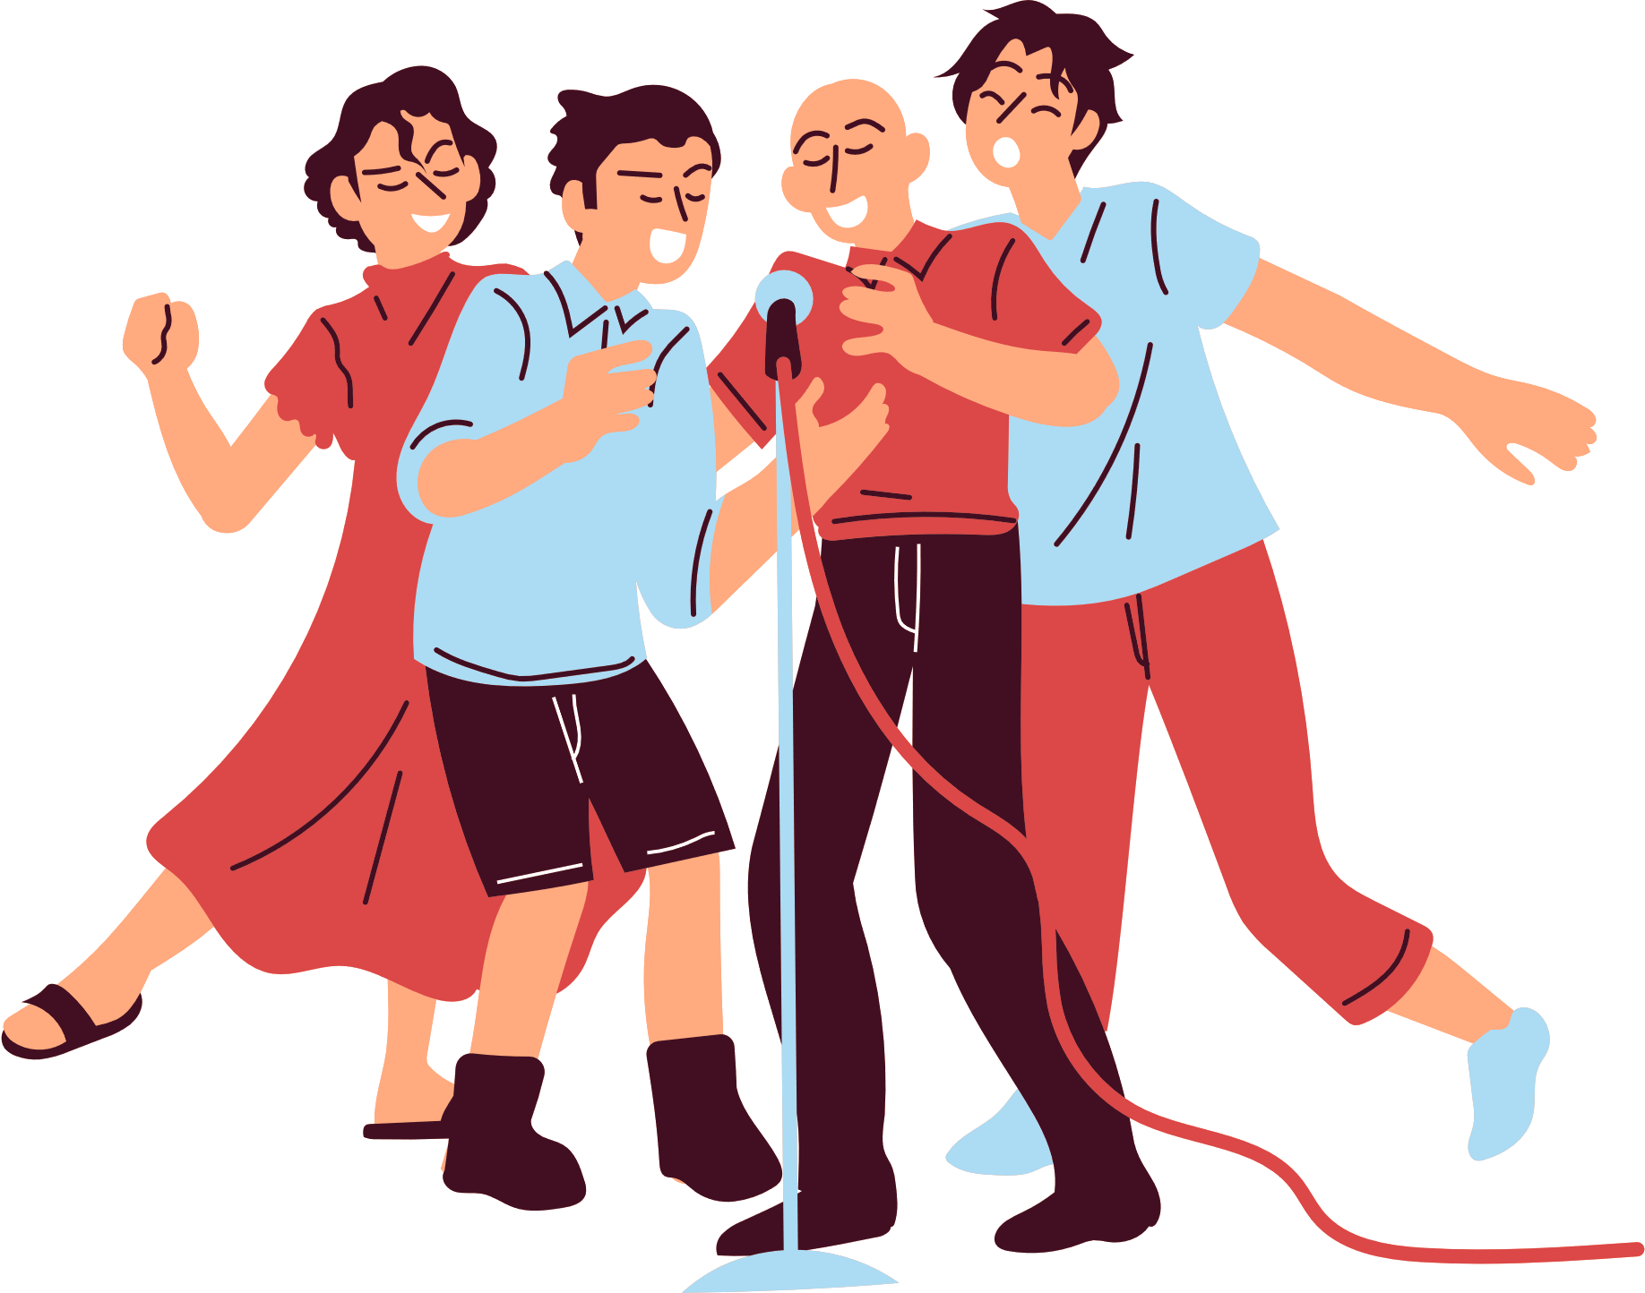
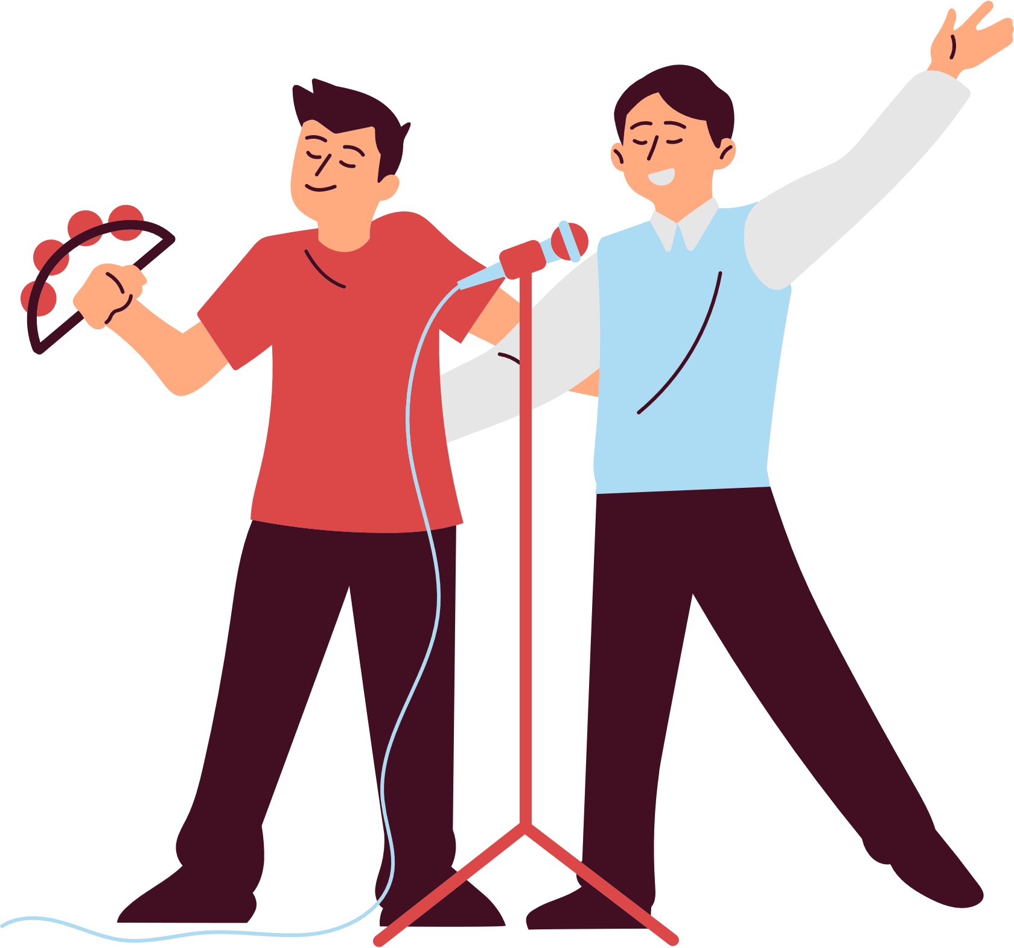
KARAOKE SHOW

Slide 6

WHAT’S THE MATTER?
Let’s go out and play.
I’m sorry. I can’t.
Why? What’s the (1) ________?
I’m not very well.
I have a (2) ___________.
Notes:
Pupils guess what the missing words are.

Slide 7

WHAT’S THE MATTER?
Let’s play and (3) __________.
I’m sorry. I can’t.
Why? What’s the matter?
I don’t feel well.
I have a (4) ______________.
Notes:
Pupils guess what the missing words are.

Slide 8


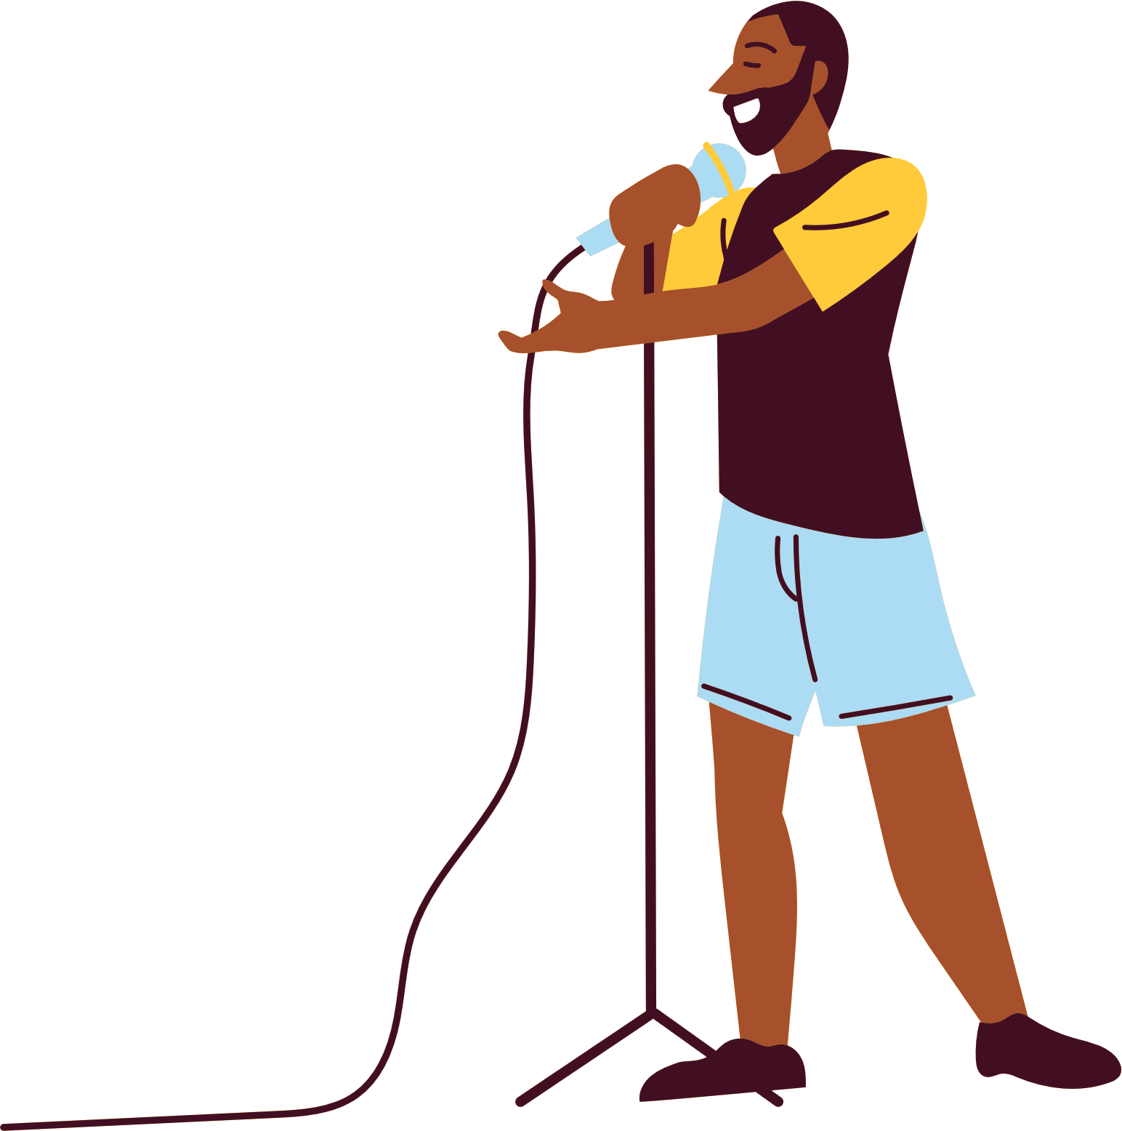
Listen and sing.
WHAT’S THE MATTER?
Let’s go out and play.
I’m sorry. I can’t.
Why? What’s the (1) ________?
I’m not very well.
I have a (2) ___________.
matter
headache
Notes:
- Have pupils listen to the song and fill in the gaps. Play the recording of the gapped sentences twice for pupils to fill in. Then check the answers as the class.

Slide 9

Listen and sing.
WHAT’S THE MATTER?
Let’s play and (3) __________.
I’m sorry. I can’t.
Why? What’s the matter?
I don’t feel well.
I have a (4) ______________.
sing
sore throat
Notes:
- Have pupils listen to the song and fill in the gaps. Play the recording of the gapped sentences twice for pupils to fill in. Then check the answers as the class.

Slide 10

Sing and clap.
WHAT’S THE MATTER?
Let’s go out and play.
I’m sorry. I can’t.
Why? What’s the (1) _____?
I’m not very well.
I have a (2) ___________.
Let’s play and (3) ________.
I’m sorry. I can’t.
Why? What’s the matter?
I don’t feel well.
I have a (4) ___________.
Notes:
- Play the recording again and have pupils sing the whole song while clapping their hands.

