Slide 2








Unit 14: STAYING HEALTHY
Lesson 1 - Period 1

Slide 3





Table of contents
1
Warm-up and Review
2
Activity 1: Look, listen and repeat.
3
Activity 2: Listen, point and say.
4
Activity 3: Let’s talk.
5
Fun corner and Wrap-up

Slide 4




01
Warm-up and Review

Slide 5






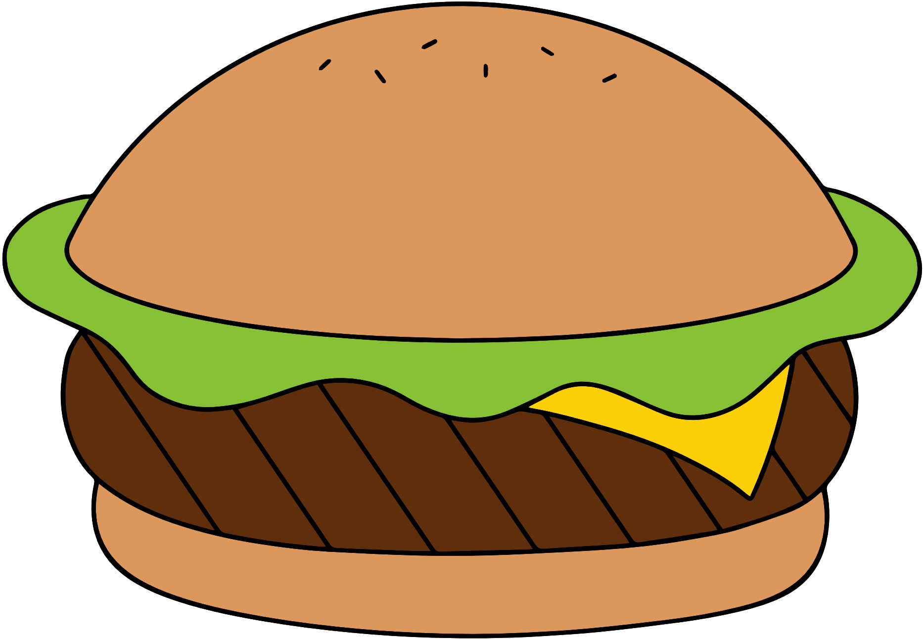





Healthy and
unhealthy food

Slide 6

Healthy food is food that gives you all the nutrients you need to stay healthy, feel well and have plenty of energy.
What's
healthy
food?

Slide 7

Unhealthy food is food that lack nutrients, vitamins and minerals. They are also high in energy, salts, sugars and fats.
What's
unhealthy
food?

Slide 8
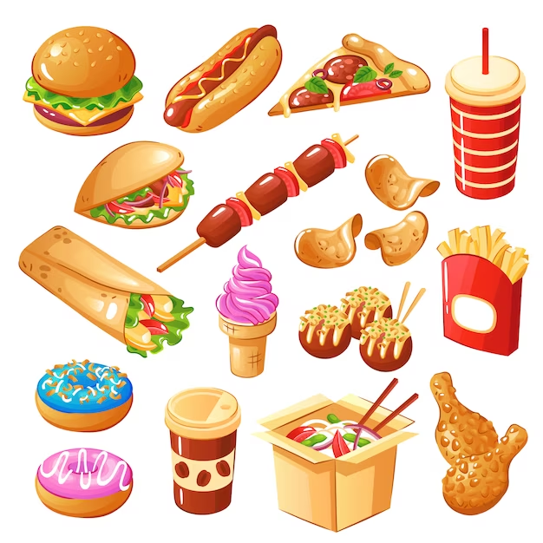

✓
healthy
unhealthy

Slide 9
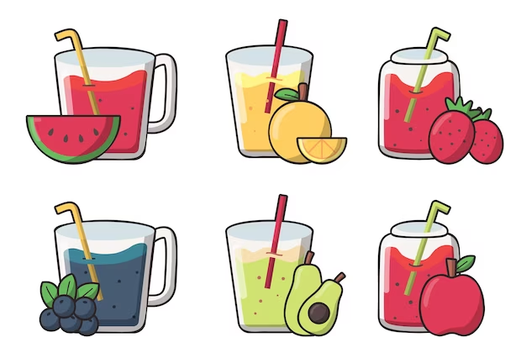
✓
healthy
unhealthy

Slide 10
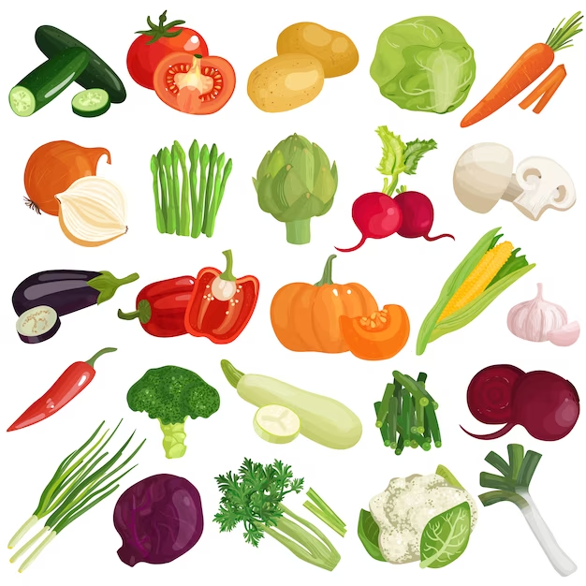

✓
healthy
unhealthy

Slide 11



02
Activity 1
Look, listen and repeat.

