Slide 2


















5
My future job

Slide 3




01.
Warm-up
and Review

Slide 4
03.
Listen, point and say.

Slide 5
03.
Let’s talk.

Slide 6



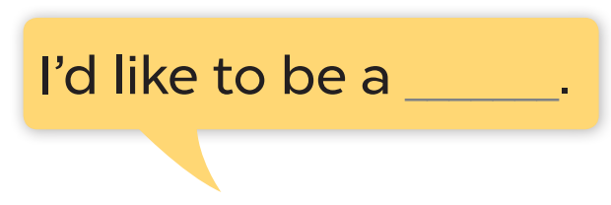
QUESTION: Question here
ANSWER: here
writer

Slide 7
Website: hoclieu.vn
Fanpage: https://www.facebook.com/tienganhglobalsuccess.vn/

